Slide 1



Daily Typing Do-Now
Open typing.com
Log into your account
Complete a 1 minute typing test
With the remaining 4 minutes
Work on a typing lesson
Play a typing game
Complete more typing tests

Slide 2
Intro to Computer Science
Anatomy of a Computer

Slide 3

Schedule
Week 2
Monday - Transistors / History of Computing
Tuesday - Anatomy of a Computer
Wednesday - Binary Day 1
Thursday - Binary Day 2
Friday - Binary Competition
Week 3
Monday - Binary Quiz (Formative)

Slide 4
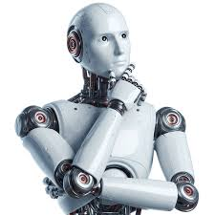
Core Functions of a Computer
Computing
Performing Calculations
Data Storage
Remembering Things
Input / Output
Responding to user actions

Slide 5
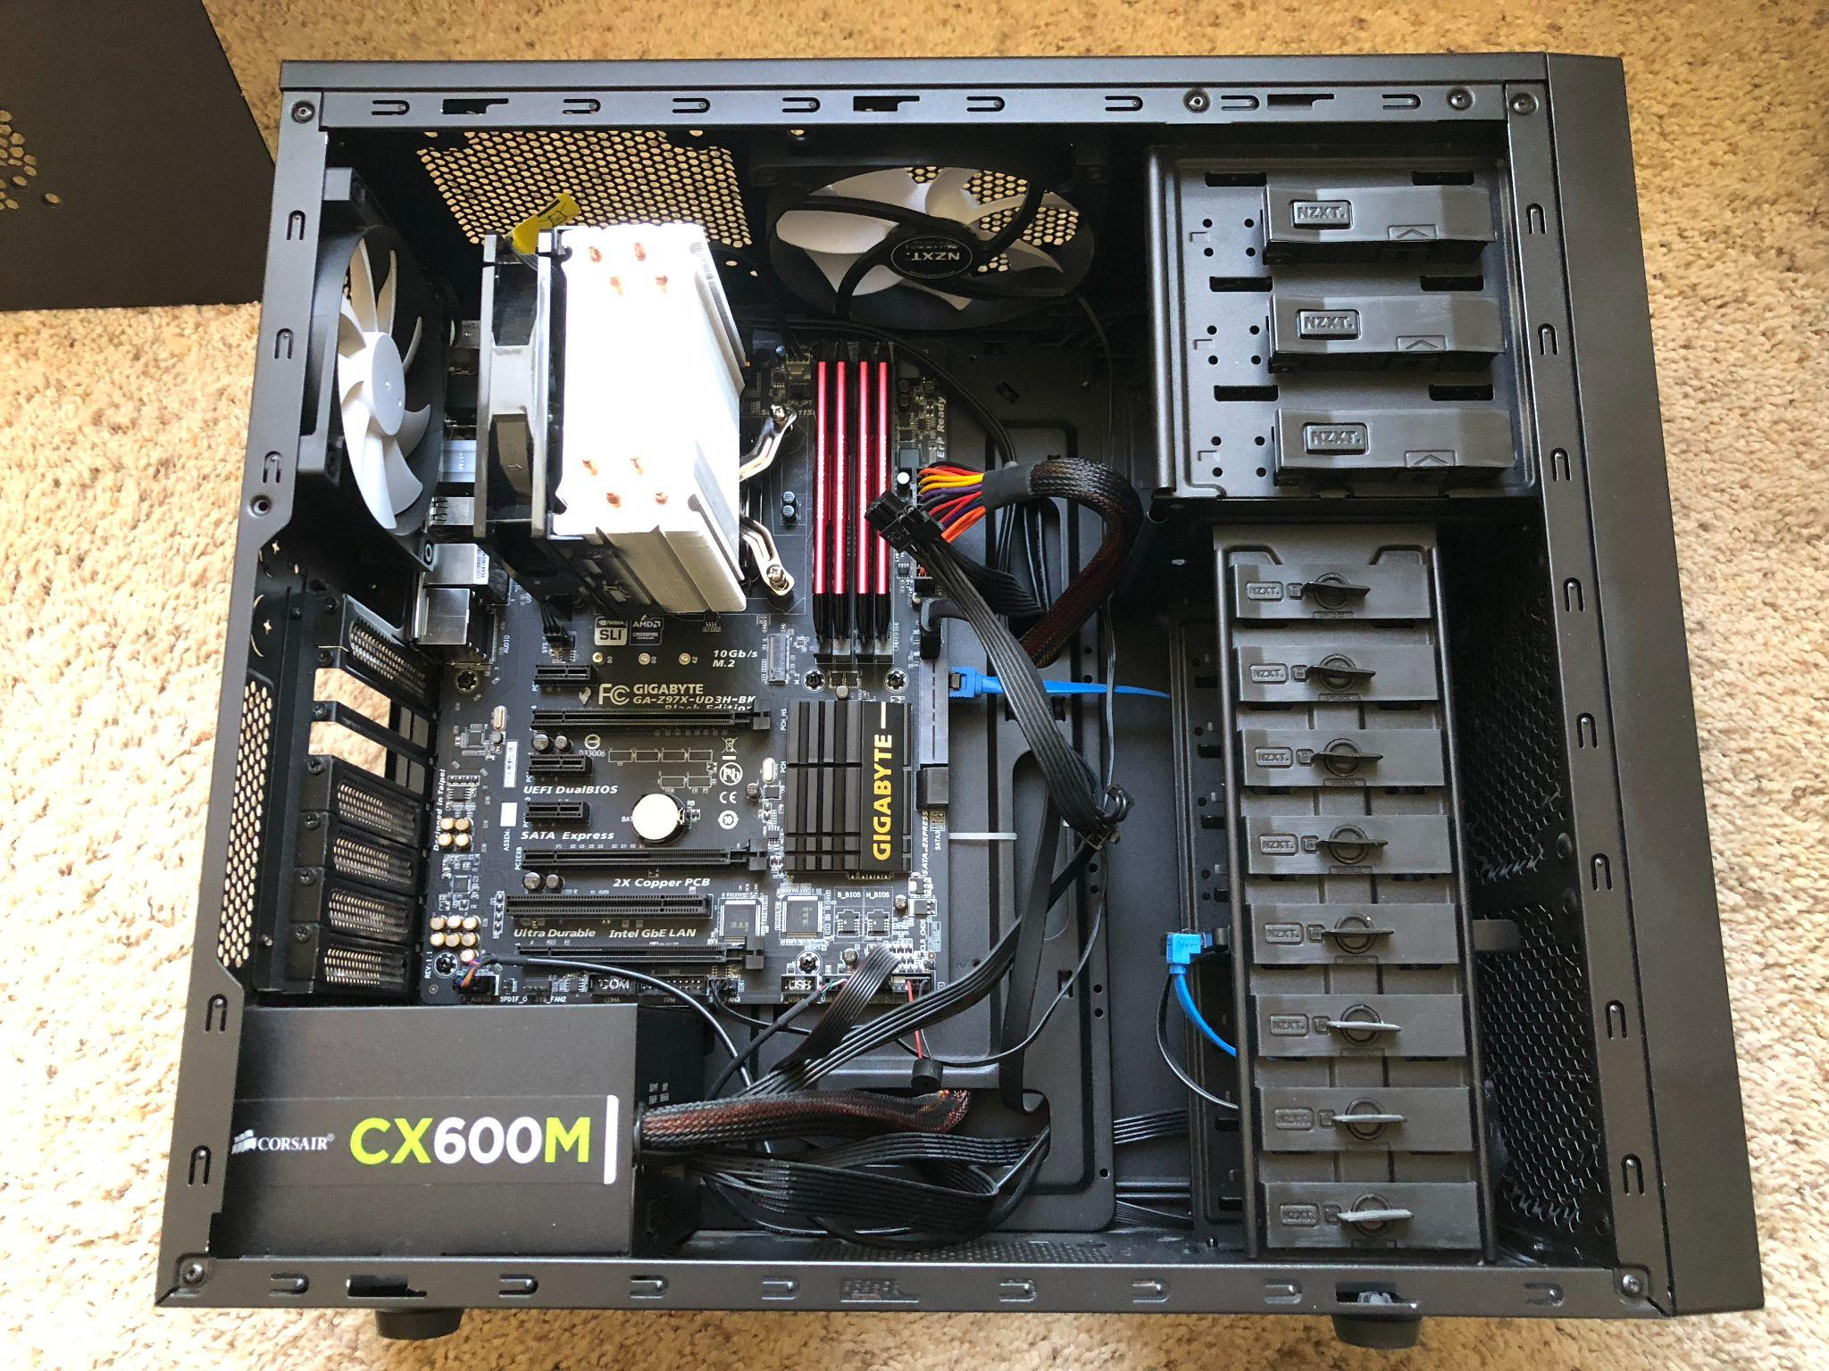
Computer Parts
Overview of Parts for..
PC
Laptop
Gaming Console
Miniature Versions of the Same Parts exist for
Phones
iPad
Smartwatch

Slide 6
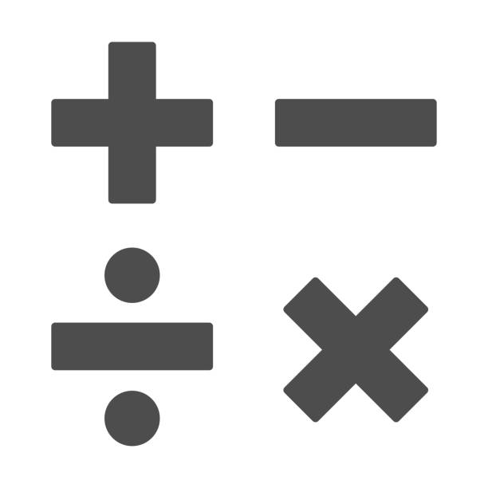
Computing Components

Slide 7
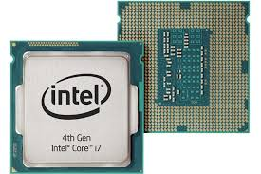
Central Processing Unit (CPU)
The “brain” of the computer.
Executes instructions and processes data.
Made up of billions of transistors that act like tiny switches, turning on and off to represent 1s and 0s.
Contains two main parts:
ALU (Arithmetic Logic Unit): Handles math and logic.
Control Unit: Directs the flow of data and instructions.

Slide 8
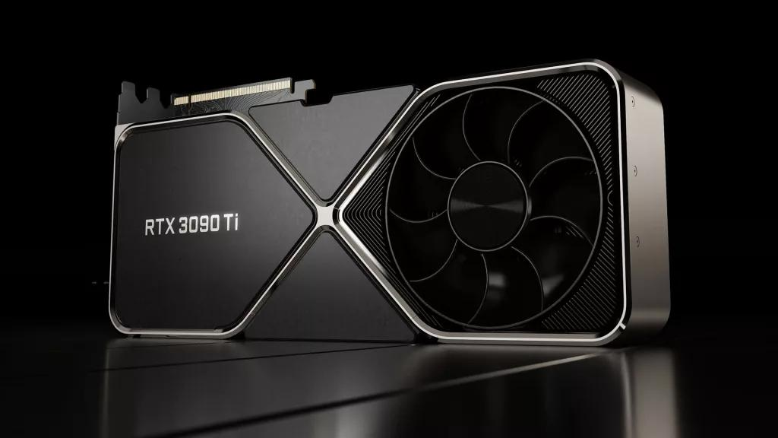
Graphics Processing Unit (GPU)
Special processor for images, video, and 3D graphics.
Optimized for parallel processing.
Often used today for AI and machine learning.
Can also be used to add extra computing power to just about any program

Slide 9
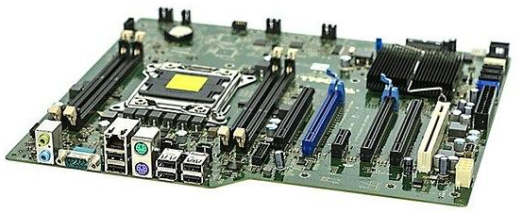
Motherboard
The main circuit board of the computer.
Connects all the parts (CPU, memory, storage, graphics, power).
Allows communication between components.
Contains then BIOS that starts the computer and sets up hardware

Slide 10
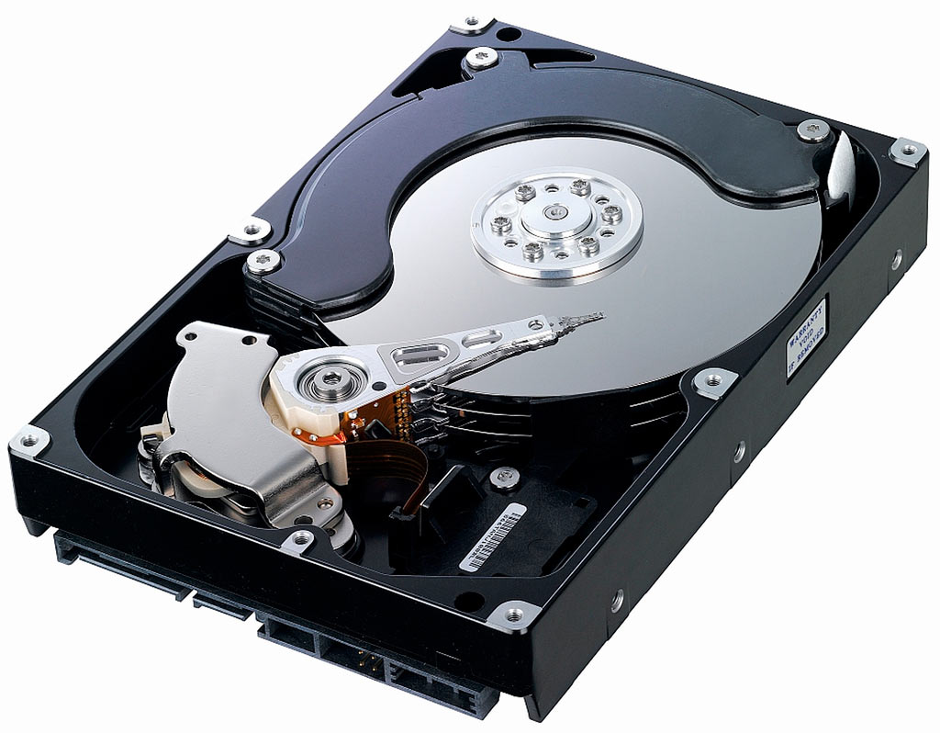
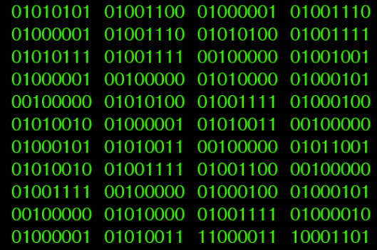
Data Storage Components

Slide 11
CPU Cache
Data stored on the CPU
On average can store about 64KB
Stored by transistor (data is lost when powered off)
Typically only stores information about calculations currently ongoing
Example: 1000 + 2000 = 3000
1000 and 2000 would be stored on the Cache

Slide 12
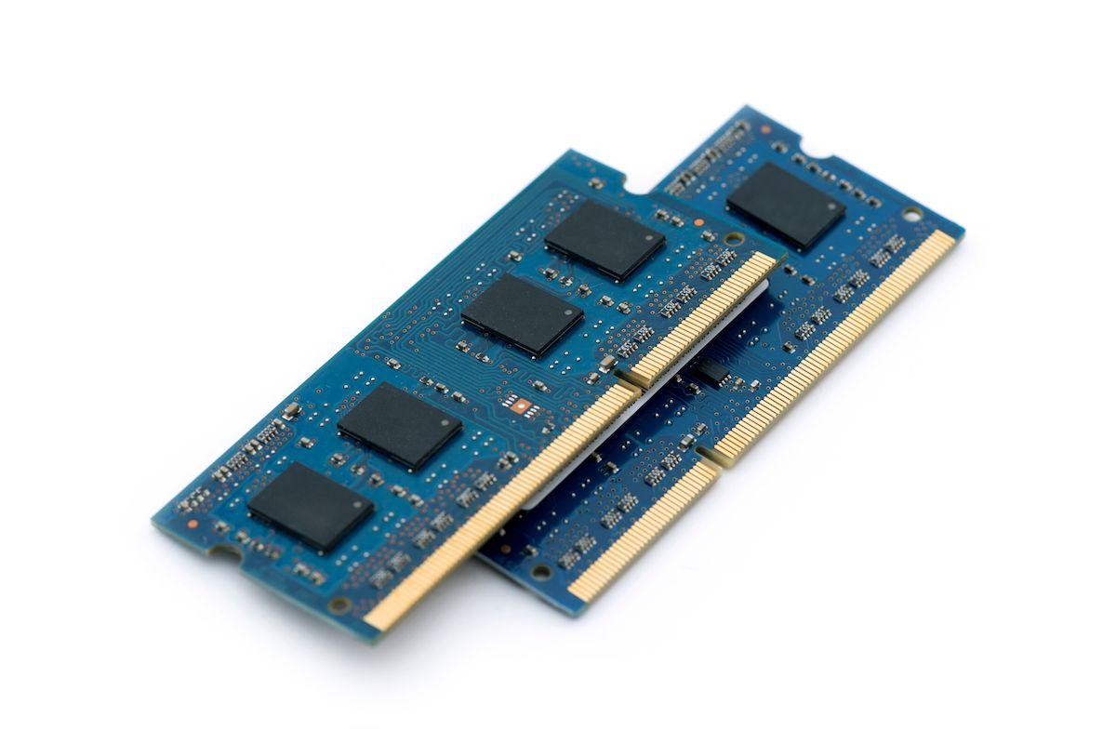
Memory (RAM)
Short-term memory of the computer.
Stores data and instructions the CPU is currently using.
Very fast, but temporary—data is lost when the power is off.
Built from transistors that hold bits of data.
On average can store around 8GB of data

Slide 13
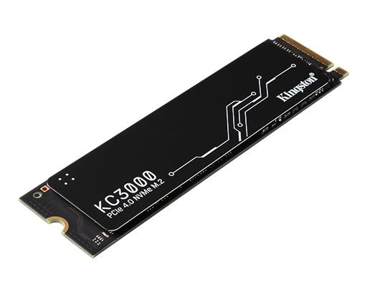
Storage (Hard Drive / SSD)
Long-term memory of the computer.
Stores files, applications, and the operating system.
Hard Drive (HDD): Uses spinning disks and magnets.
1s and 0s physically etched into the disk
Think vinyl record player
Solid State Drive (SSD): Uses transistors in flash memory for faster access.
Retains some electrical charge in the SSD when powered off

Slide 14
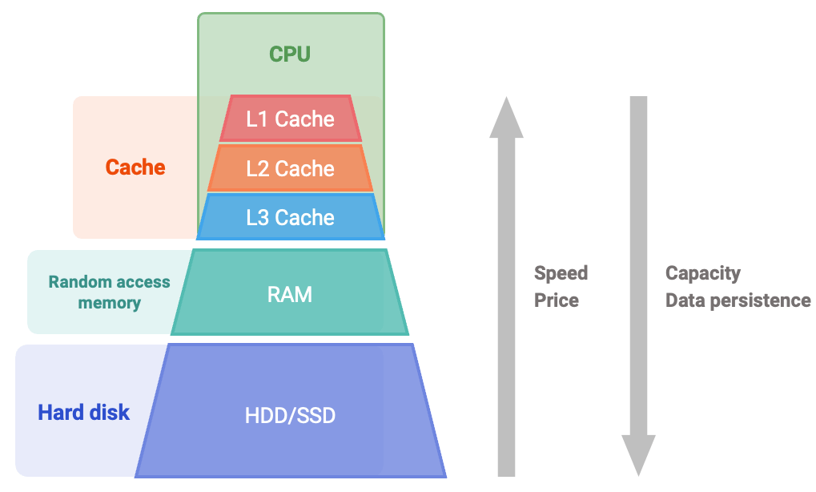
Data Storage Hierarchy

Slide 15
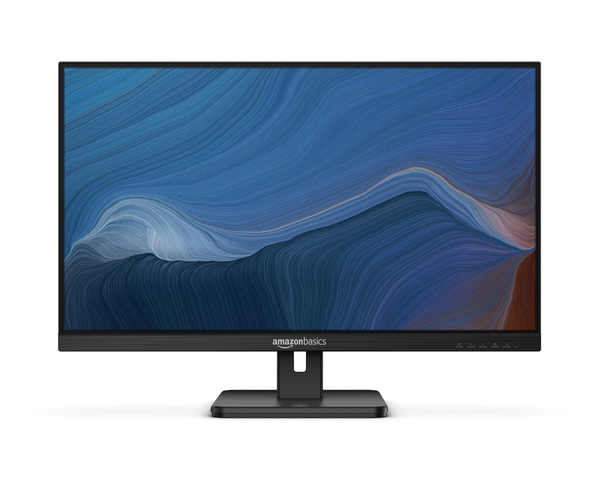
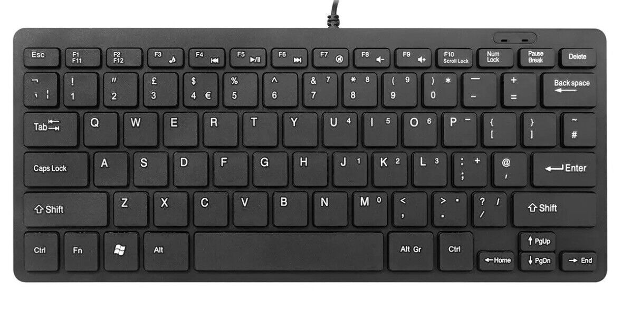
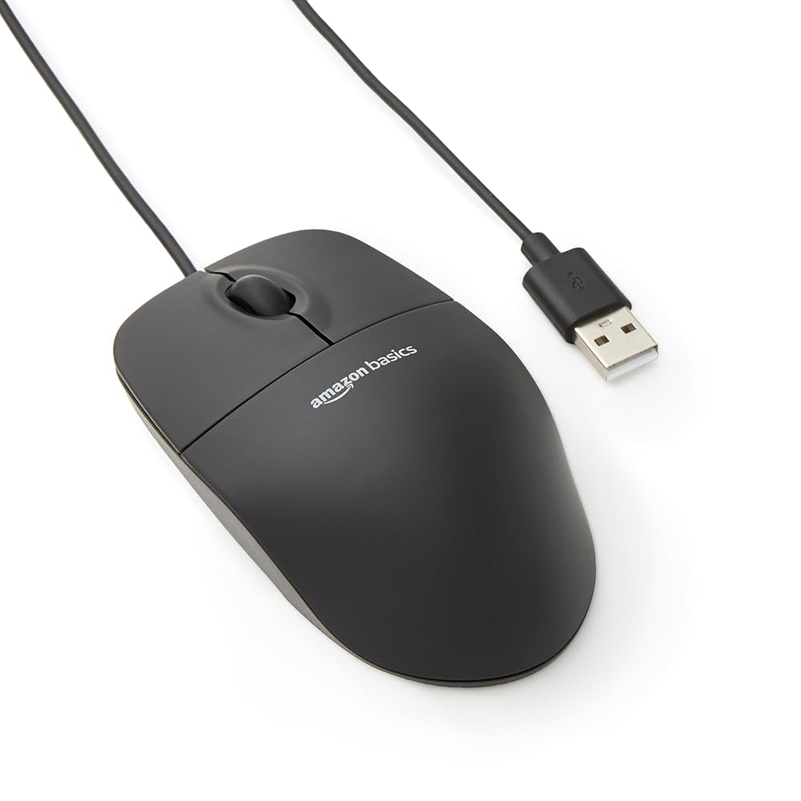
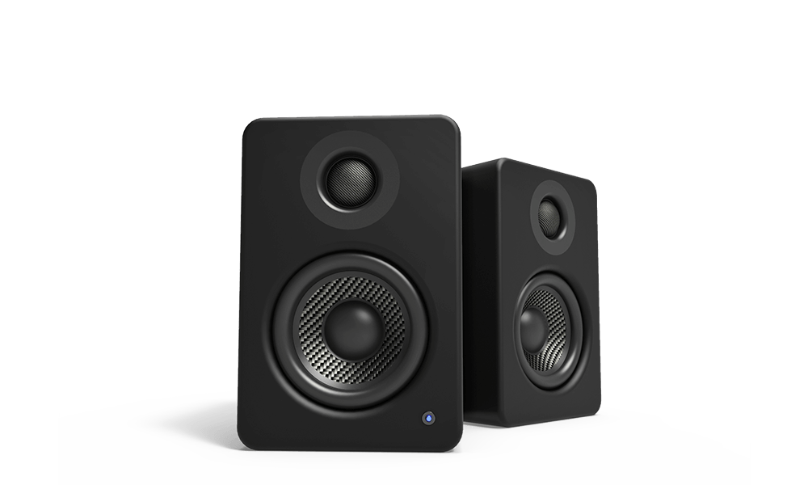
Input / Output Devices

Slide 16
Computer Parts Blooket
Go to classroom.google.com
Select our class
Click on the Computer parts Blooket

